Slide 1
KMP Applications
Mostafa Saad Ibrahim
Teaching Assistant @ Cairo University
Software Engineer @ NTPSoftware

Slide 2
Palindrome & Failure Function
Problem: Given a string, What is the longest suffix that is palindrome?
aaaa => aaaa
abc => c
abcdeffe -> effe
Or, the reverse problem: Given a string, What is the longest prefix that is palindrome?
We will use the 2 problems to help us solve them.

Slide 3
Palindrome & Failure Function
abcdeffe => effe in suffix problem
effedcba => effe in prefix problem
Let’s assume char @ will not be part of input..let’s construct:
effedcba@ abcdeffe
Now problem, find longest prefix that is suffix
Failure function can answer that easily: F[size-1] is answer

Slide 4
Palindrome & Failure Function
Problem: Given a string, What is the minimum characters to add to convert string to palindrome?
aaaa => aaaa
abc => abcba
abcdeffe -> abcdeffedcba
Your turn ☺

Slide 5
Repetition & Failure Function
Let concatenate(S, N) = SSSS …N times
concatenate(abcd, 3) = abcdabcdabcd
Given String concatenated, find minimum N
E.g. Given abcdabcdabcd => 3
E.g. Given abababab => 2
It is also can be abab 2 times, but ab smaller
E.g Given abc => 1

Slide 6
Repetition & Failure Function
a | b | c | d | a | b | c | d | a | b | c | d
0 | 0 | 0 | 0 | 1 | 2 | 3 | 4 | 5 | 6 | 7 | 8
As we match longest proper prefix NOT longest prefix
F[len-1] will fail such that covering all repetition except last one
That is if string is 10 times concatenated, The first 9 blocks = last 9 blocks
=> here abcdabcd = abcdabcd
So we can get the block easily => Len – F[Len-1] = 12 – 8 = 4
Observation: Len % (Len – F[Len-1] ) = 0

Slide 7
Repetition & Failure Function
a | b | c | d | a | b | c | d | a | b | c | d
0 | 0 | 0 | 0 | 1 | 2 | 3 | 4 | 5 | 6 | 7 | 8
Sol: if Len % (Len – F[Len-1] )= 0 then Len – F[Len-1] is solution
Why if so, all blocks are equal
Let String S = con(abcd, 5) = abcdabcdabcdabcdabcd
Let’s divide string for 5 blocks ABCDE
F[Len-1] = 20, which means first 20 = last 20…
or first 4 blocks = last 4 blocks Then: ABCD = BCDE
Then A = B = C = D = E

Slide 8
Repetition & Failure Function
a | b | c | d | e | g | g | h | a | b | c | d
0 | 0 | 0 | 0 | 0 | 0 | 0 | 0 | 1 | 2 | 3 | 4
Len – F[Len-1] = 8 => 12 % 8 != 0
What does this mean? first 4 = last 4, but in between is not like them

Slide 9
Repetition & Failure Function
a | b | c | d | e | g | g | h | a | b | c | d
0 | 0 | 0 | 0 | 0 | 0 | 0 | 0 | 1 | 2 | 3 | 4
Len – F[Len-1] = 8 => 12 % 8 != 0
What does this mean? first 4 = last 4, but in between is not like them

Slide 10
Repetition & Failure Function
Another way, using KMP itself
Let String input P = abcdabcdabcd
Let S = p+p = abcdabcdabcdabcdabcdabcd
Now when we try to find P in S, it should match in 0, k, 2k and so on. So 2nd match is enough for answer
abcdabcdabcdabcdabcdabcd => 2nd match
abcdabcdabcd

Slide 11
All prefixes & Failure Function
Problem: Given string P, For each prefix, count its frequency
E.g aabaaab => 5 3 2 1 1 1 1
E.g. a appeared 5 times and aa appeared 3 times
A basic approach will try every prefix and search whole string in O(n^2)

Slide 12
All prefixes & Failure Function
Remember the prefix function expresses longest proper prefix that is a suffix
For a prefix to exist in mid of S, it will be suffix for a prefix
E.g. in aabaaab, prefix aa exist as suffix of 3 prefixes: aa, aabaa, aabaaa
If for each prefix we counted these suffixes, we efficiently listed the prefixes them

Slide 13
All prefixes & Failure Function
a | a | b | a | a | a | b
0 | 1 | 0 | 1 | 2 | 2 | 3
2 locations fail at 2
Prefix 2 appeared 1 time + 2 from failure
aa = 3

Slide 14
All prefixes & Failure Function
a | a | b | a | a | a | b
0 | 1 | 0 | 1 | 2 | 2 | 3
Think A fails over B,
Which fails over C,
Which fails over D
And so on
2 locations fail at 1
2 locations fail at 2 which fail at a
2+2 + 1
a = 5

Slide 15
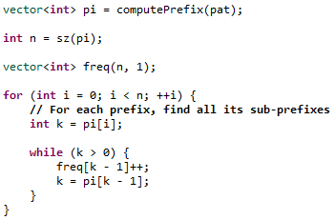
All prefixes & Failure Function

Slide 16
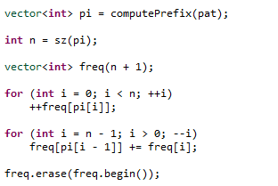
All prefixes & Failure Function
Your Turn ☺
How this O(n) works

Slide 17
All prefixes & Failure Function
Problem: Given string P, For each prefix, count its frequency in String T
Hint1, make use of the previous processing
Hint2: Construct string P@T where @ is character that won’t appear in P or T

Slide 18
Count # of unique prefixes
Given String, count # of suffixes that don’t appear again as substring….Or problem reverse
Given String, count # of unique prefixes
Remember, When prefix fails on location, it means this location will be prefix later
So, mark all location that we fail on as repeated prefixes…remaining are unique

Slide 19
Count # of unique prefixes
For example, count unique prefixes for abab
a -> appears later -> ignore
ab -> appears later -> ignore
aba Unique
abab Unique

Slide 20
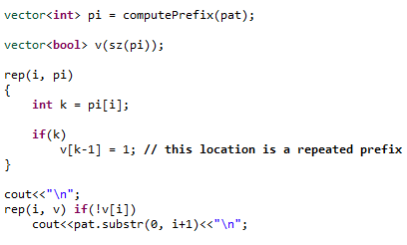
Count # of unique prefixes

Slide 21
Count # of distinct substring
abc => has a, b, c, ab, bc, abc
aaa => has a, aa, aaa
aabab => a, b, aa, ab, ba, aab, aba, bab, aaba, abab, aabab
Think Incrementally: If we know the answer for the first N letters…Could we know for the N+1?
When we add the N+1 character, we have N+1 suffix. We need only the unique suffixes of them.
For each prefix P => O(n^2)
Count += CountUniquePrefixes( reverse(P) )

Slide 22
KMP Cheat Sheet
Key words: substring, prefix, suffix, string equalities
Typically processing for the Pattern, similar to Input S
Try to find solution in: S, SS, rev(S), S@S, and so on

